Slide 1

Lesson 3: Python is better than R

Slide 2


Slide 3

Let’s process some data!

Slide 4

Review
What function do we use to load a csv file?
What is the structure of ggplot2?
read_csv()
data, mapping, geometries

Slide 5
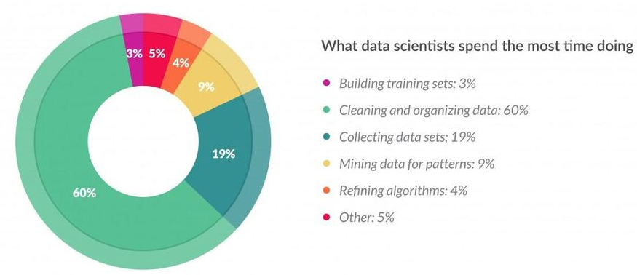
~80% of time “munging” data

Slide 6


Slide 7
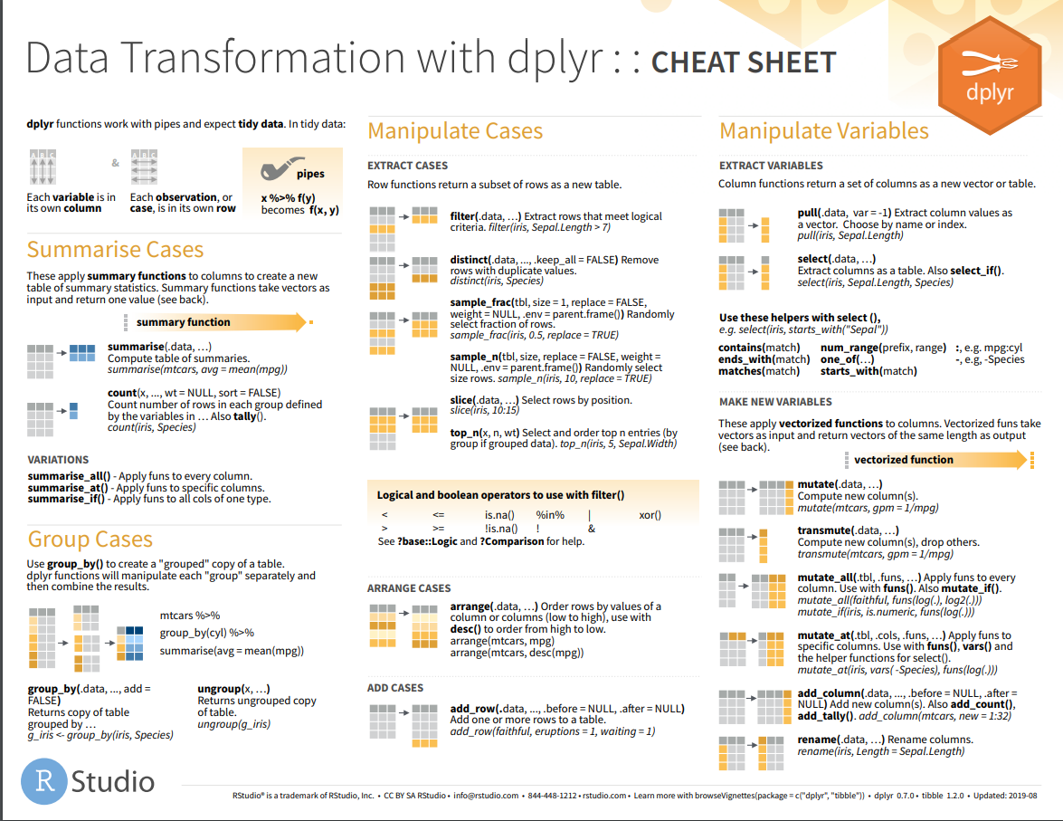

Slide 8


Slide 9

What we learned
Theory:
Light processing with dplyr
Practice:
Conditions and/or
select
pull
filter
group_by
summarize
arrange
count
:
names
modify_if(is.factor, as.character)

